Slide 1

Attacking scada systems: story of scadastrangelove
SCADA STRANGELOVE
SCADA.SL
Sergey Gordeychik
Aleksandr Timorin
Gleb Gritsai
*All pictures are taken from Dr StrangeLove movie and other Internets

Slide 2

whoami
Aleksandr Timorin lifecycle:
Studied mathematics (OMG!)
Python developer
Penetration tester
ICS security researcher:
  Industrial protocols fan and 0-day PLC hunter
  SCADAStrangeLove team member
atimorin
atimorin@protonmail.ch

Slide 3
AGENDA
WWW: who are we, why are we and what are we for ?
Milestone
Projects:
  Past
  Present
  Future
Results

Slide 4
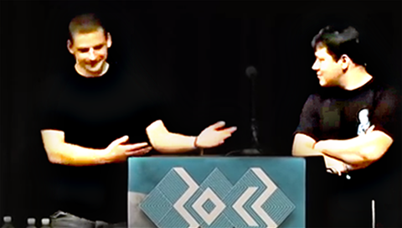
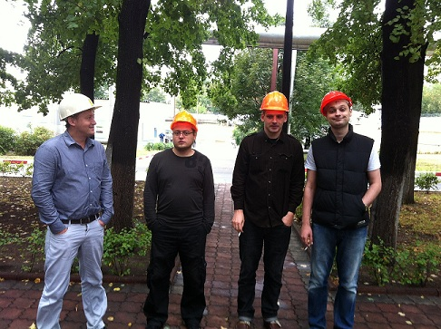
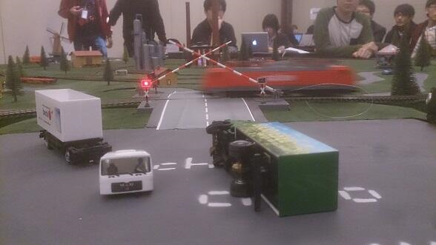
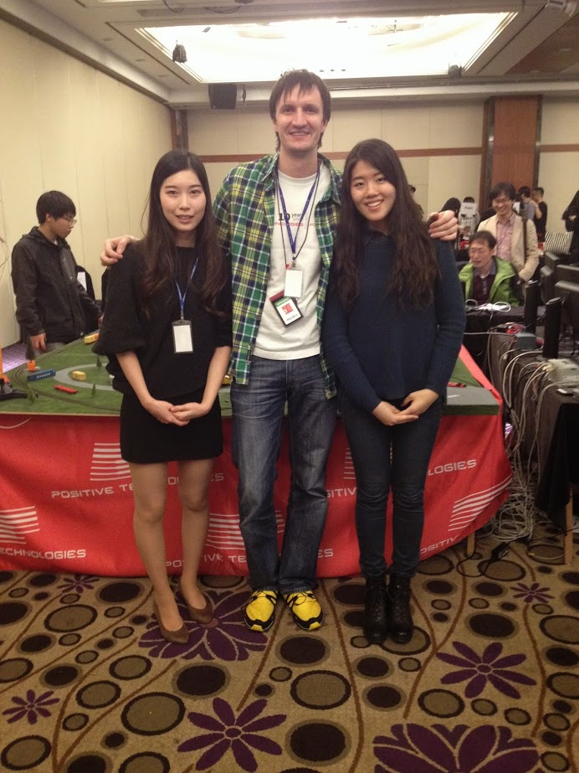
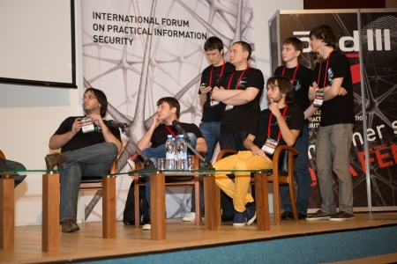
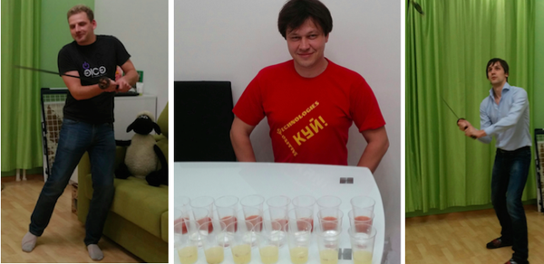
WWW

Slide 5
@scadasl
Group of security researchers focused on ICS/SCADA
to save Humanity from industrial disaster
and to keep Purity Of Essence
Alexander Timorin Alexander Tlyapov Alexander Zaitsev Alexey Osipov Andrey Medov Artem Chaykin Denis Baranov Dmitry Efanov Dmitry Nagibin | Dmitry Serebryannikov Dmitry Sklyarov Evgeny Ermakov Gleb Gritsai Ilya Karpov Ivan Poliyanchuk Kirill Nesterov Roman Ilin Sergey Bobrov | Sergey Drozdov Sergey Gordeychik Sergey Scherbel Timur Yunusov Valentin Shilnenkov Vladimir Kochetkov Vyacheslav Egoshin Yuri Goltsev Yuriy Dyachenko

Slide 6
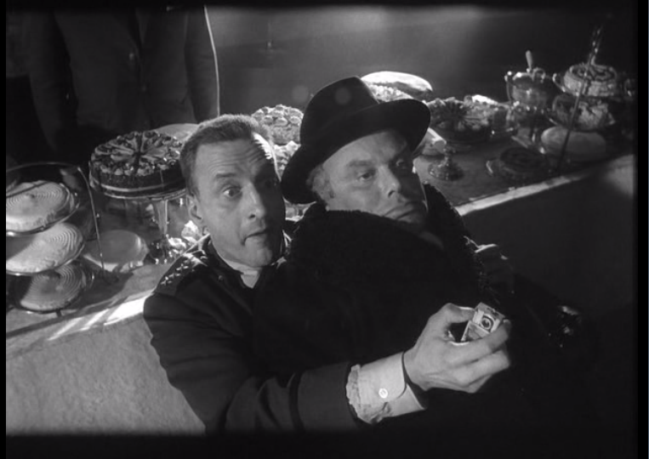
WWW
We work for community and as community

Slide 7
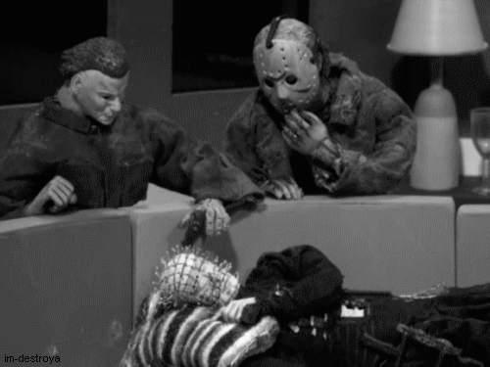
WWW
Since Stuxnet (2010) ICS industry especially security has been warned.

Slide 8
WWW
ICS is everywhere
Old technologies without classic and modern security principles
ICS networks “isolated”, but connected to other nets, other nets connected to Internet
Sometimes (shodan/censys/zmap/masscan proved) ICS devices connected to the Internet directly
Hacking ICS without money does not attract evil guy
Engineers tend to say “this works for a long period of time! Don’t touch it!”
Notes:
For eample DS in your window – easy target for evil guy. Bud good news and only one – he is not economically motivated to do this. No profit! He prefer to hack banks and so on

Slide 9

WWW
But reality shows us that evil guys touch them and ICS so tender
We was worried about it.
We didn’t accept this approach.
We decided to change situation.
Then SCADASTRANGELOVE was born

Slide 10
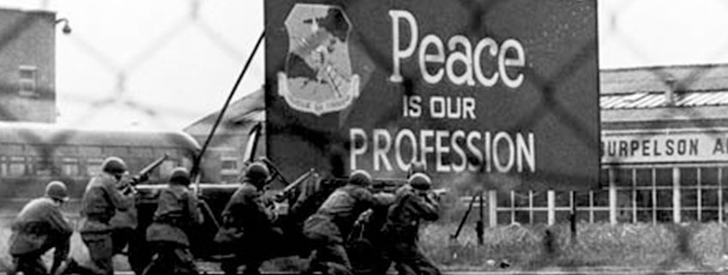
WWW
Peace is our profession!

Slide 11

WWW
As a group of researchers we work in different companies
Not only one company with private atmosphere
Everybody can be a member

Slide 12
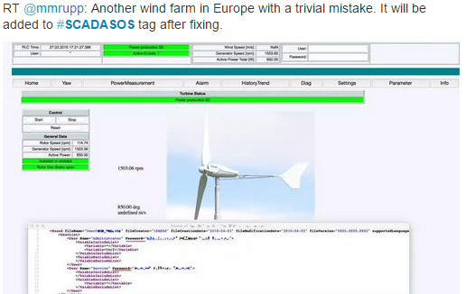
WWW
Members has their own projects but still contributing to long-term projects #SCADAPASS and #SCADASOS

Slide 13
WWW
We regularly give a talks worldwide in security conferences: CCC, Power of Community, CodeBlue, PacSec, PHDays, Zeronights, Confidence, Hack.lu …
We show and share our results with community
We share researches of our projects
We share toolkits, scripts, dorks, analytics and statistics

Slide 14
Milestone
2012: only 4 members
From 2013 to 2016: over 30 members
Over 100 0-dayz
Tons of vulnerabilities: binary, web, default credentials and so on
Different industries: from transportation to renewable energy

Slide 15
Milestone
Vulnerabilities:
Memory errors
Cryptofails
Web
Special “features” (aka backdoors)
Default and hardcoded credentials
Industrial protocols
Fun but non-profit

Slide 16
Milestone
Vulnerabilities:
Siemens
General electric
Schneider electric
Yokogawa
Honeywell
Abb
Advantech
etc

Slide 17
Milestone
Vulnerabilities:
Server/client scada software
PLC, HMI, RTU
Protective relays, actuators, converters
Smart meters, data concentrators
Network switches, gateways
Gsm/gprs modems
etc

Slide 18
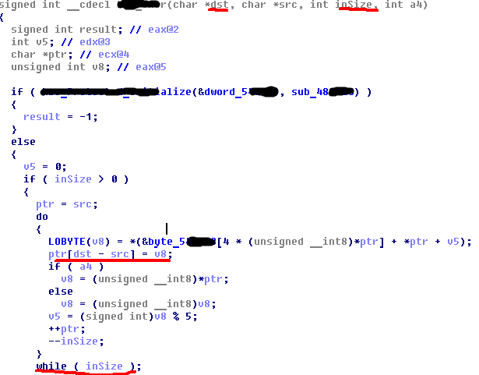
Input validation: Buffer overflow
Honeywell EPKS, CVE-2014-9189

Slide 19
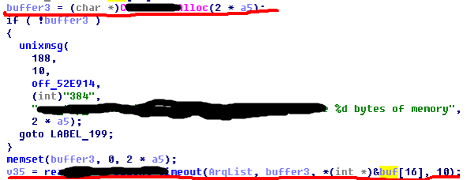
Input validation: Buffer overflow (2)
Honeywell EPKS, CVE-2014-9187

Slide 20
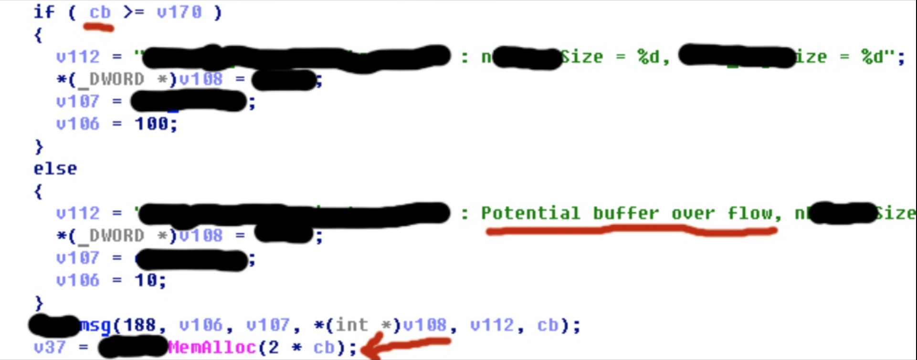
Input validation: God help us all
cb is a buffer size

Slide 21

Input validation: Buffer overflow
SpiderControl SCADA Web Server, stack-based bof, CVE-2015-1001

Slide 22
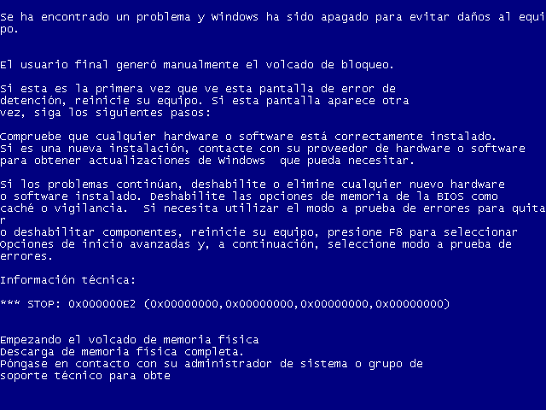
Notes:
JUST A BSOD_JOKE!

Slide 23
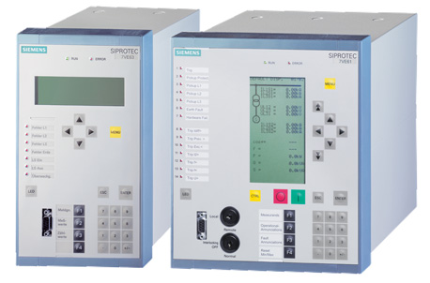
RCE?
to get firmware?
to get debug symbols?
to debug?
..PowerPC
no “operation system”

Slide 24
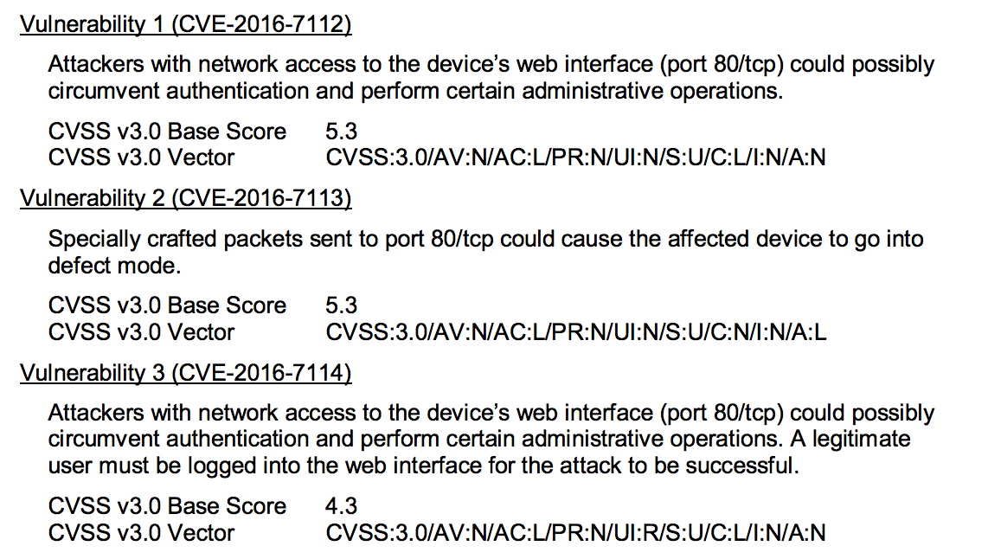
SSA-630413: Vulnerabilities in SIPROTEC 4

Slide 25
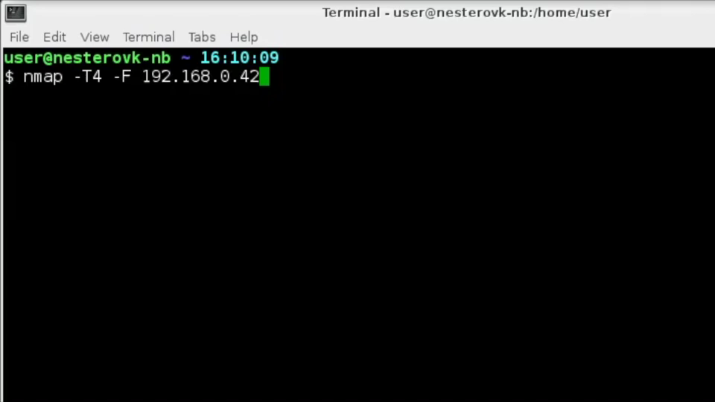

Slide 26
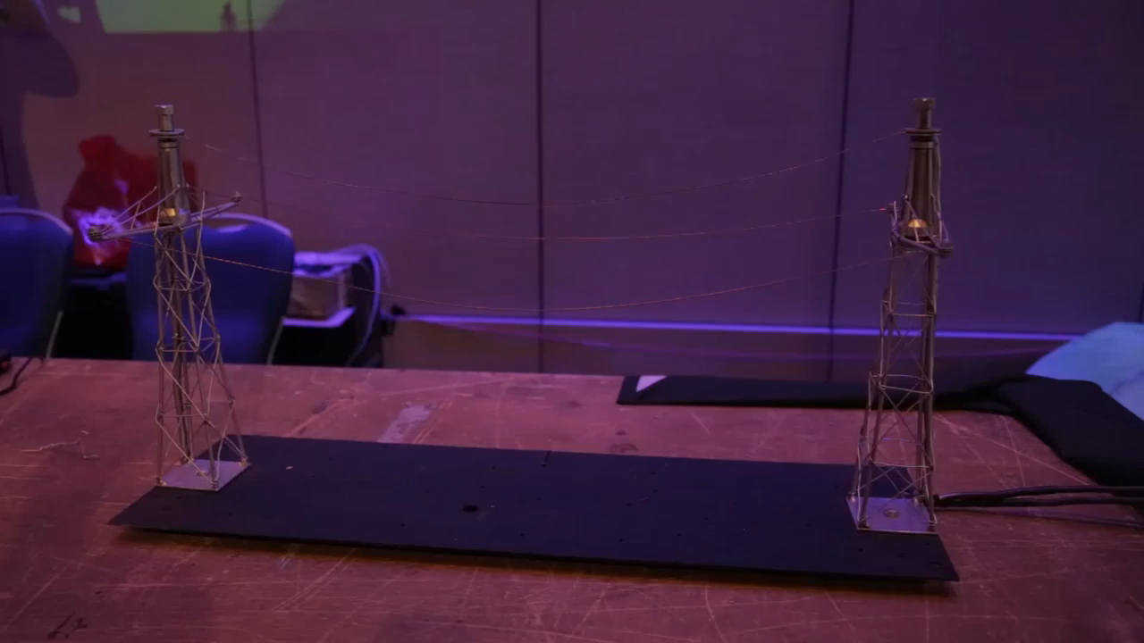

Slide 27
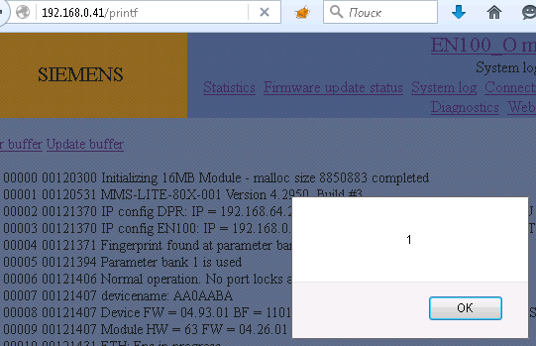
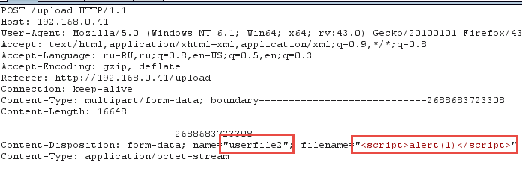
Code vulnerabilities
Siemens SIPROTEC 7SJ64 (protective relay) XSS

Slide 28
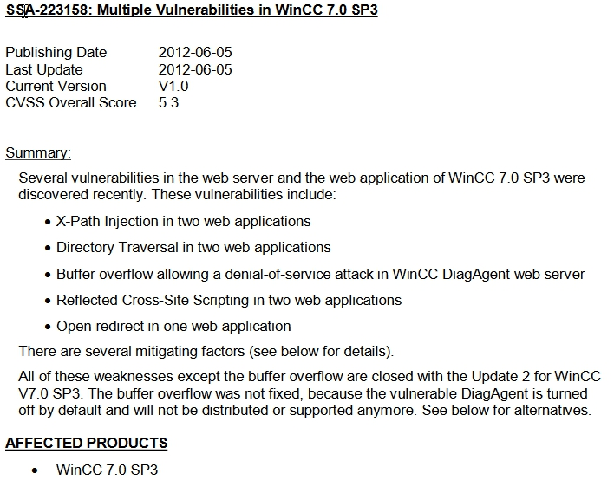
Code vulnerabilities
Siemens WinCC

Slide 29
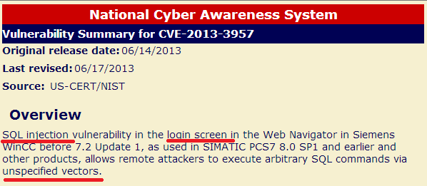
Story of CVE-2013-3957

Slide 30
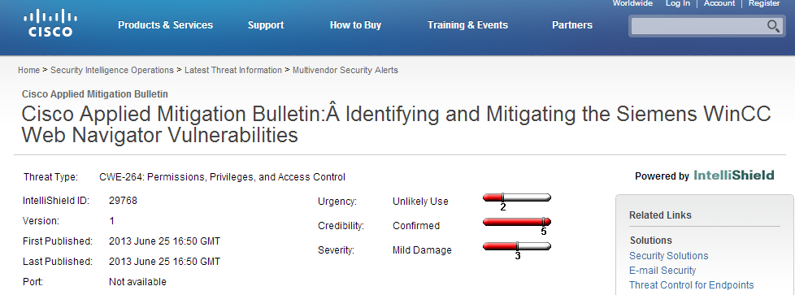

Cisco for the rescue!

Slide 31
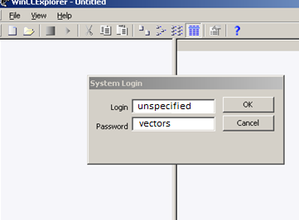
WinCC SCADA-Clients?
WinCCExplorer.exe/PdlRt.exe
Create and use your own security features
Instead of standard features – that’s
A bad idea!

Slide 32
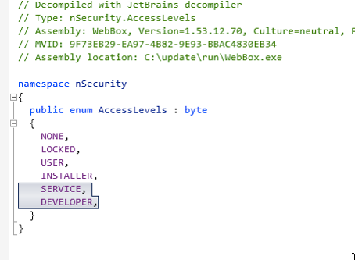
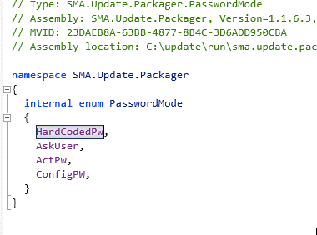
Hardcoded secrets
Hardcodes are for protocols with auth: SNMP, telnet, HTTP, etc.
You can hardcode keys, certificates, passwords
SMA Sunny WebBox

Slide 33
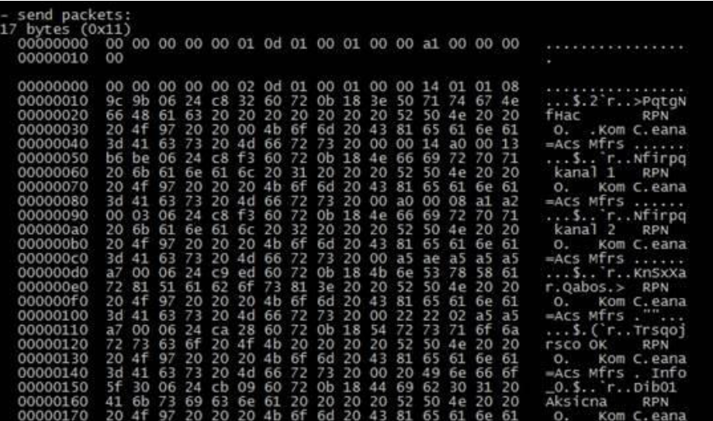
Hardcoded secrets
Siemens SIPROTEC 4 protective relay confirmation code “311299”:
  System log
  Device info
  Stack and other
  parts of memory
  More ?

Slide 34
Hardcode secrets
Siemens SIPROTEC 4 protective relay confirmation code “311299”:
  “SIPROTEC 4 and SIPROTEC Compact devices allow the display of extended internal statistics and test information…
  To access this information, the confirmation code “311299” needs to be provided when prompted.”
  “...Siemens does not publish official documentation on these statistics. It is strongly recommended to work together with Siemens SIPROTEC customer care or commissioning experts to retrieve and interpret the statistics and test information...”

Slide 35
Please change IP address to <whatever>
Siemens S7-1200 PLC, CVE-2014-2252
“An attacker could cause the device to go into defect mode if specially crafted PROFINET packets are sent to the device. A cold restart is required to recover the system. ”
Just “set” PROFINET request: set network info (ip, netmask, gateway) with all zero values.

Slide 36
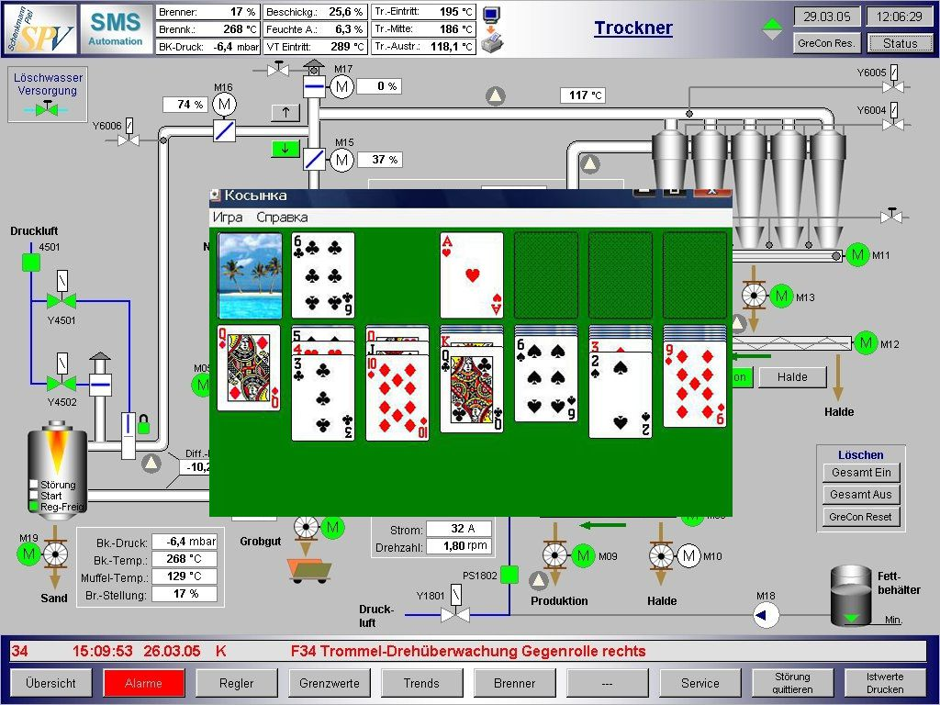
Kiosk mode restrictions bypass
KIOSK mode:
Limit access to OS functions

Slide 37
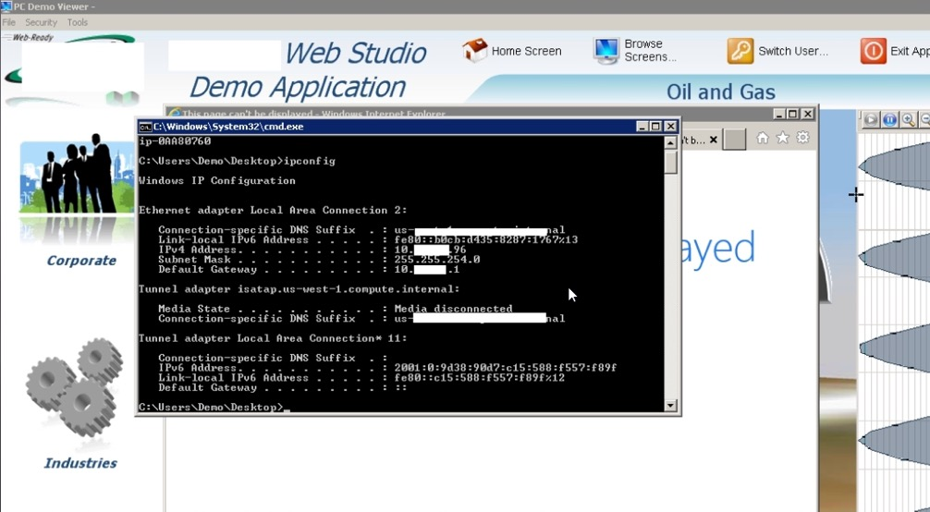
Kiosk mode restrictions bypass
KIOSK mode: Limit access to OS functions

Slide 38
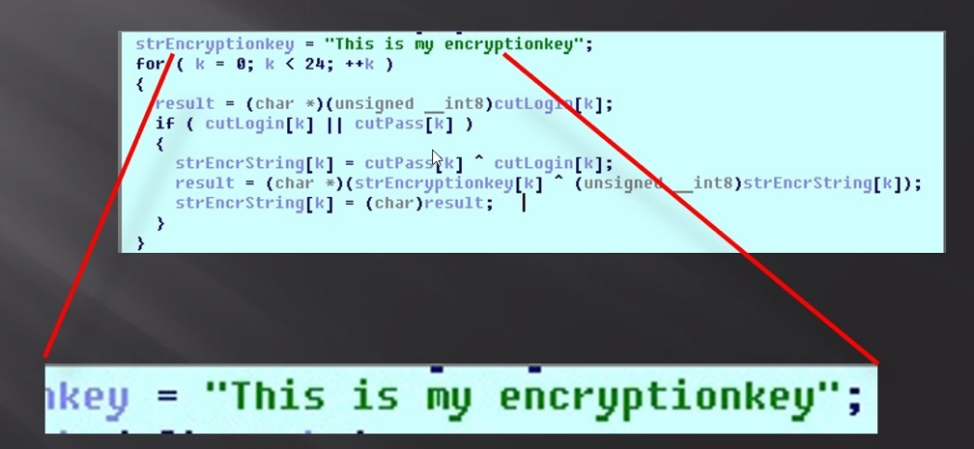
Cryptofails: hardcoded key for XOR, lol
Wincc accounts: “secret” crypto key

Slide 39
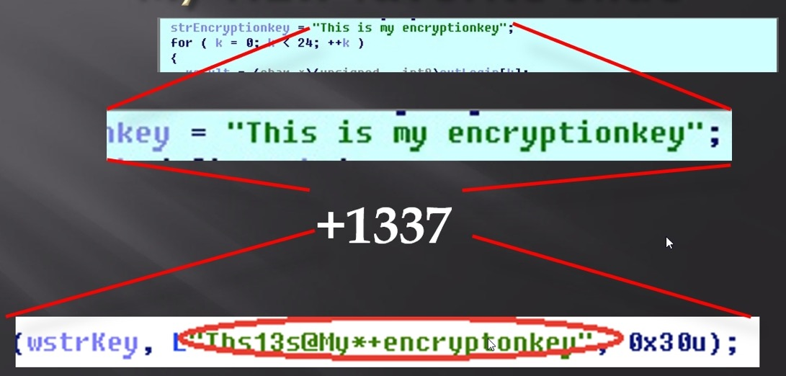
Cryptofails: hardcoded key for XOR, lol
WinCC accounts: “secret” crypto key fixed
It’s XOR, they should not bother hardcoding for XOR

Slide 40
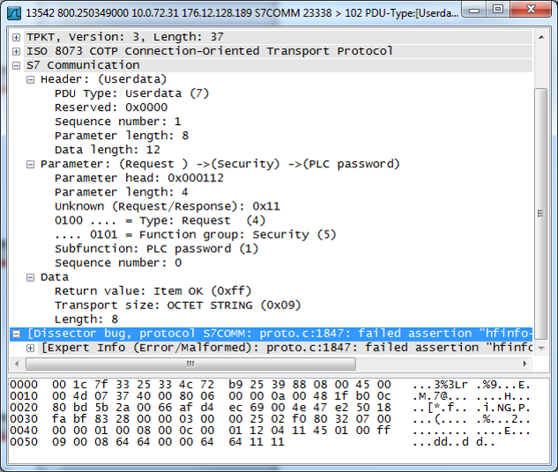

Cryptofails: Elusive OR
PLC password “encryption”
Password (8 bytes)

Slide 41
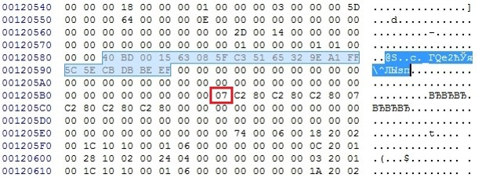
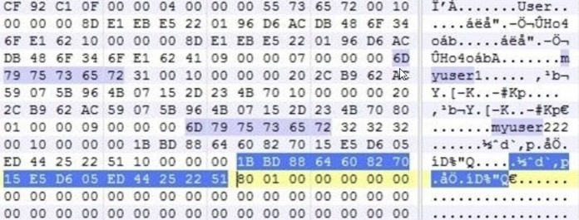
Cryptofails: weak algorithms
TIA Portal PEData.plf passwords history

Slide 42
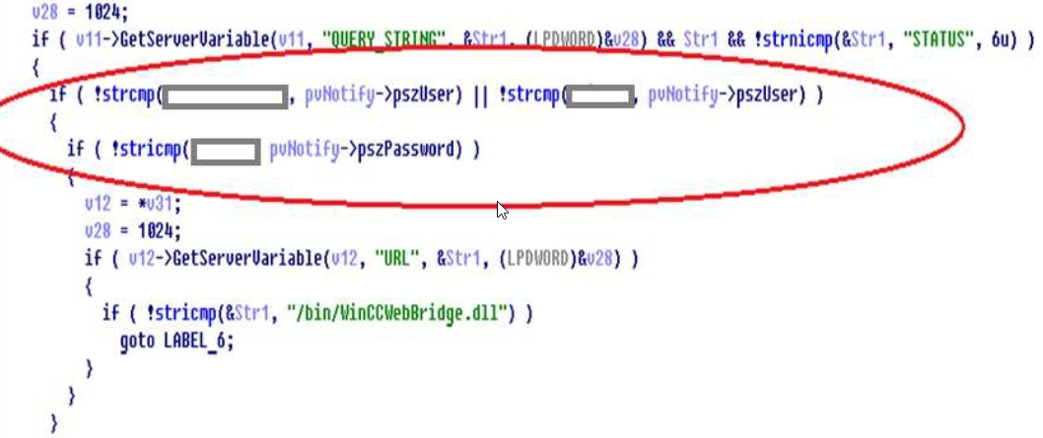
Cryptofails: Plain and Clear
Winccwebbridge.dll: please hash your hardcoded account

Slide 43
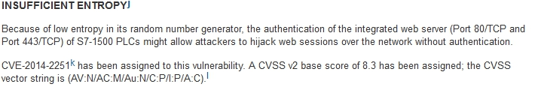
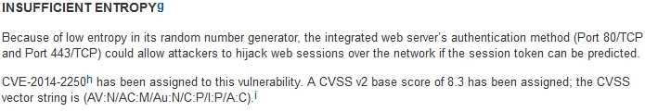
Cryptofails: weak PRNG
Siemens S7-1200, S7-1500 PLC, CVE-2014-2250, CVE-2014-2251

Slide 44
Cryptofails: weak PRNG
Siemens S7-1200, S7-1500 PLC, CVE-2014-2250, CVE-2014-2251
Seed = plc_start_time + const

Slide 45
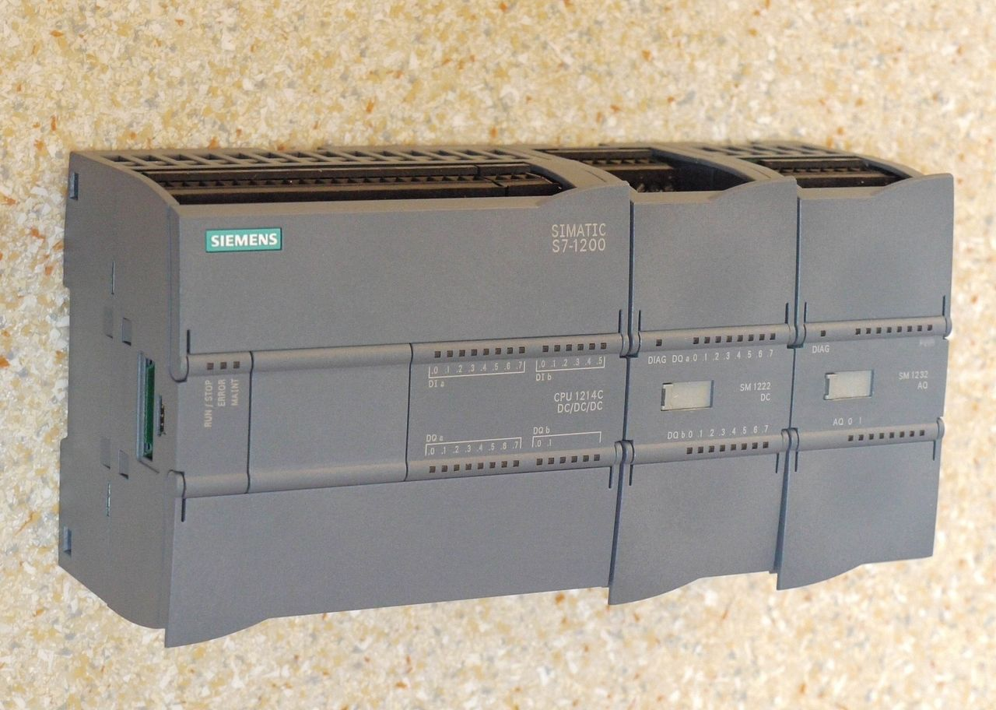
Story of PLC ownage
Target – Siemens S7-1200 PLC

Slide 46
Story of PLC ownage
PmzR9733Q8rG3LpwjCGZT9N/ocMAAQABAAKK1woAqsgAAAAAAAAAAIrXIUM=
uLiHXZUTy2GMgjr1KmgmcNN/ocMAAQACAAKK1woAqsgAAAAAAAAAAIrXIUM=
Mu/vgiIgtrxq0LVp26nkMtN/ocMAAQADAAKK1woAqsgAAAAAAAAAAIrXIUM=
tjH6vtNWCfa+QZHPDtCnKdN/ocMAAgADAAKK1woAqsgAAAAAAAAAAIrXIUM=
3e6cd1f7bdf743cac6dcba708c21994fd37fa1c30001000100028ad70a00aac800000000000000008ad72143
b8b8875d9513cb618c823af52a682670d37fa1c30001000200028ad70a00aac800000000000000008ad72143
32efef822220b6bc6ad0b569dba9e432d37fa1c30001000300028ad70a00aac800000000000000008ad72143
b631fabed35609f6be4191cf0ed0a729d37fa1c30002000300028ad70a00aac800000000000000008ad72143

Slide 47
Story of PLC ownage
3e6cd1f7bdf743cac6dcba708c21994f MD5 of ? (16bytes)
d37fa1c3 CONST (4 bytes)
0001 user logout counter (2 bytes)
0001 counter of issued cookies for this user (2 bytes)
00028ad7 value that doesn’t matter (4 bytes)
0a00aac8 user IP address (10.0.170.200) (4 bytes)
00000000000000008ad72143 value that doesn’t matter (12 bytes)
What about 3e6cd1f7bdf743cac6dcba708c21994f ?

Slide 48
Story of PLC ownage
MD5( NEXT 26 BYTES OF COOKIE + 16BYTES OF SECRET + 2 NULL BYTES)
What is SECRET ?
SECRET generates after PLC start by ~PRNG.
PRNG is a little bit harder than standard C PRNG.
SEED in {0x0000 , 0xFFFF}

Slide 49
Story of PLC ownage
SEED very often depends on time value
SEED = PLC START TIME + 320
320 by practical way: secret generates after ~ 3-4 seconds of PLC start using current time
PLC START TIME = CURRENT TIME – UPTIME
Current time via web interface
Uptime via SNMP with hardcoded
read community string “public”

Slide 50
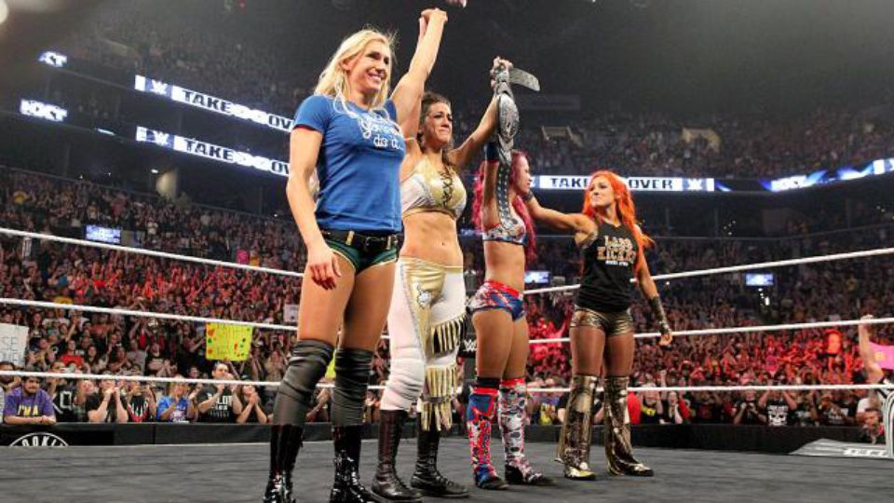

Story of PLC ownage
Profinet “feature” and PRNG vulnerability - real attack vector. Result - PLC takeover.

Slide 51
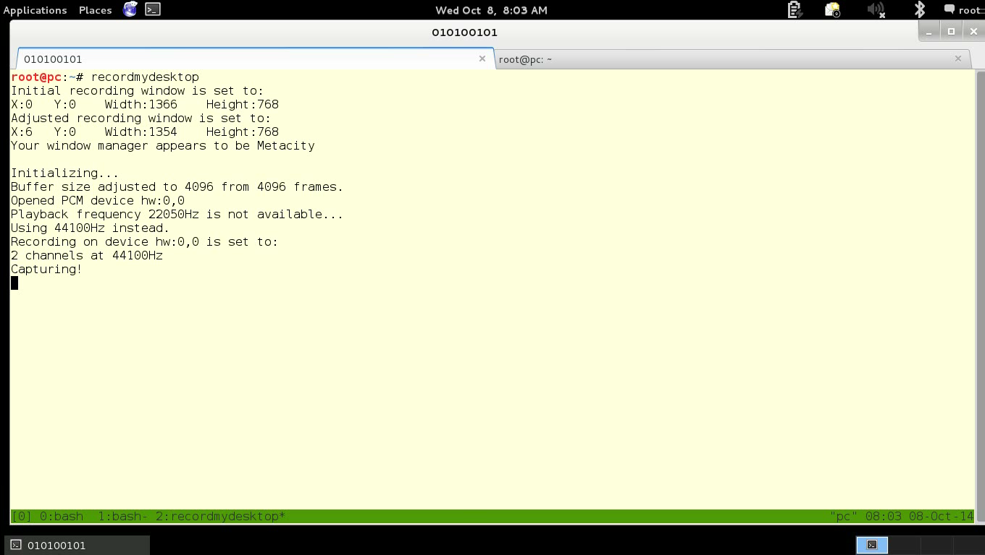

Slide 52
Cryptofails: Your hand in mine
- Hash passwords
- SHA is not good enough
- Put length of plaintext nearby
Redbox_value = len(pwd)*2+1

Slide 53
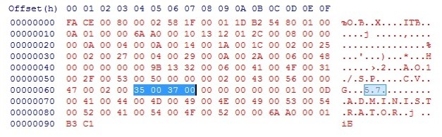
Industrial protocols
“Secure” set up speed of energetic turbine
More details at “SCADA deep inside: protocols and security mechanisms”

Slide 54
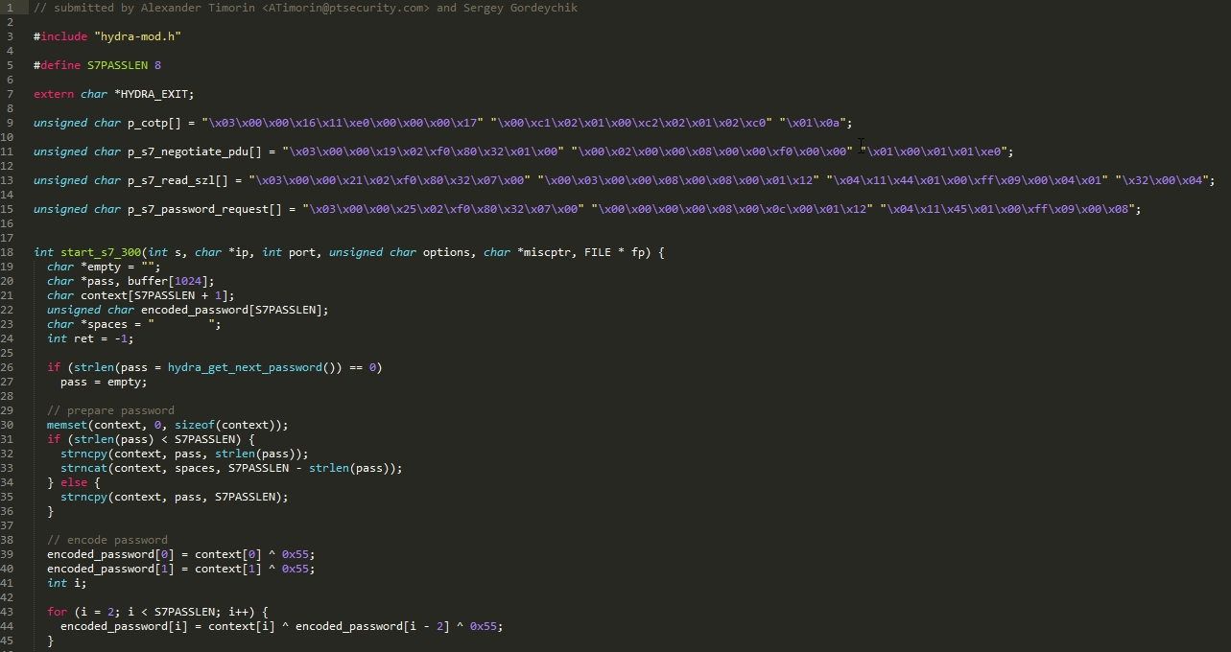
Industrial protocols
Industrial protocols: S7-300 PLC password cracker.
Included in the popular tool thc-hydra.

Slide 55
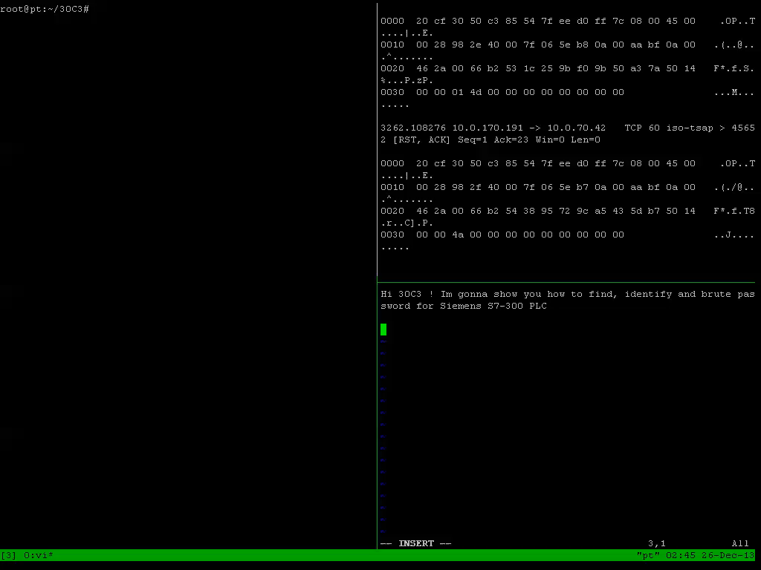
Vulnerabilities #5

Slide 56
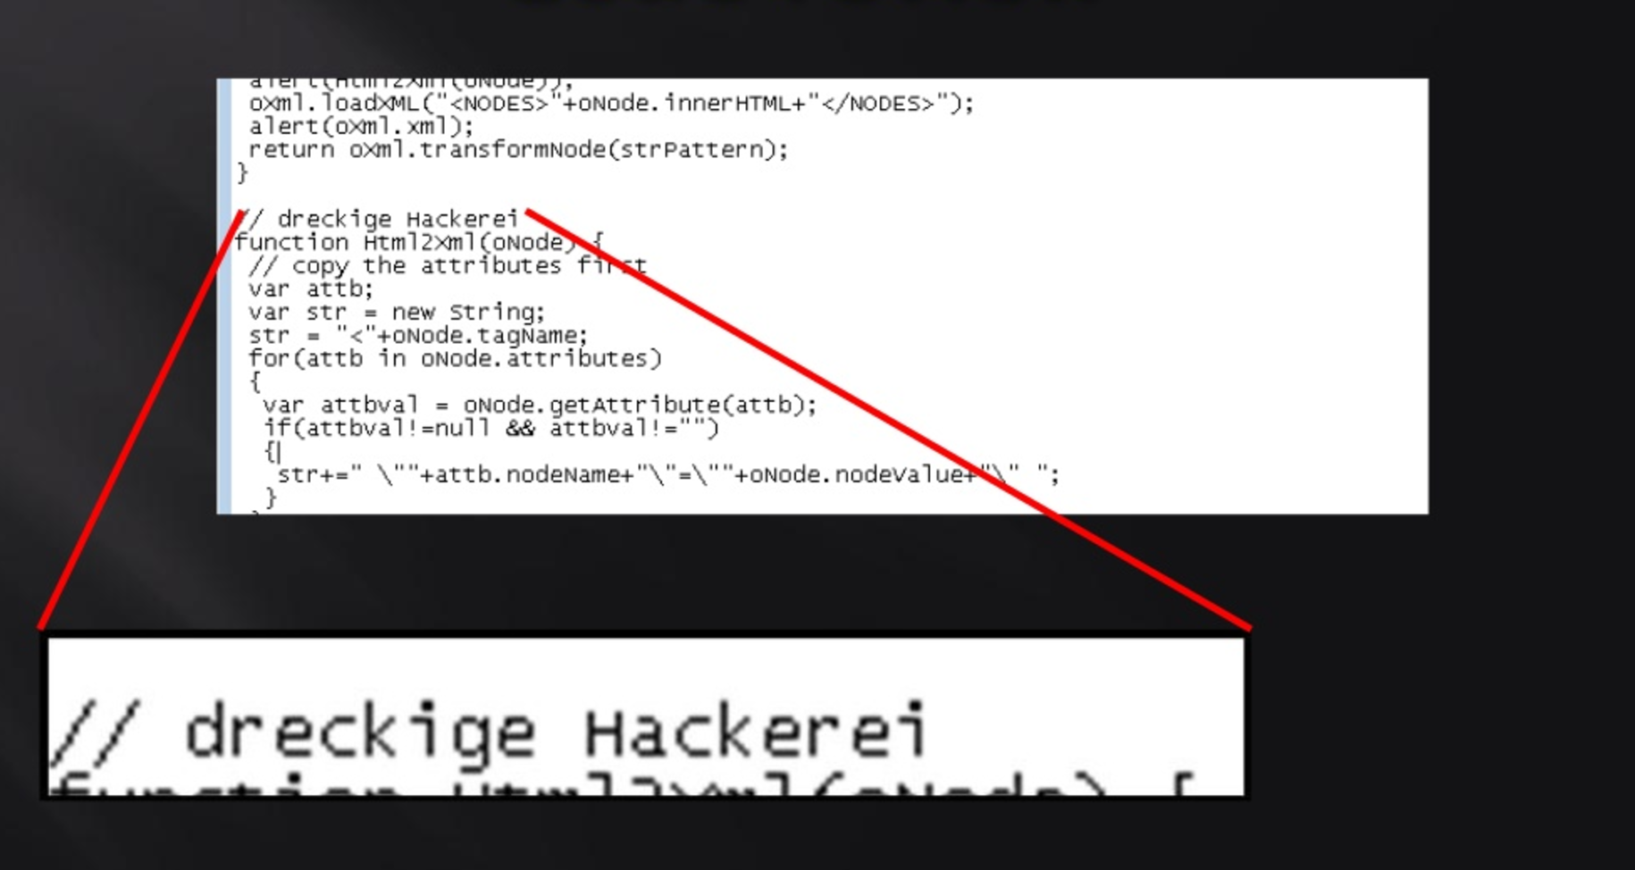
harrassment

Slide 57
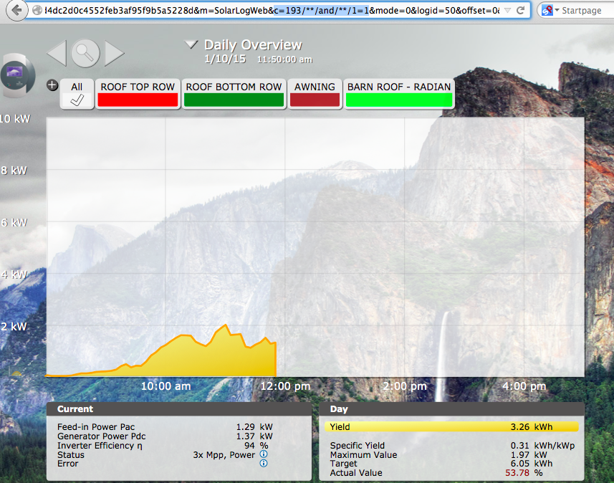
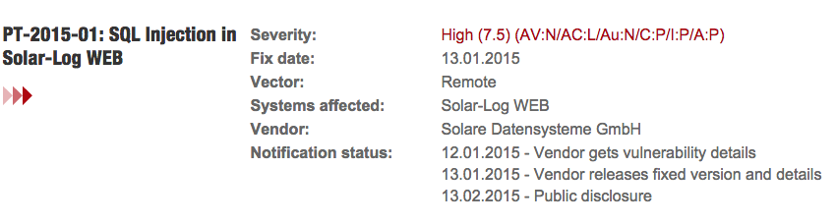
FyN

Slide 58
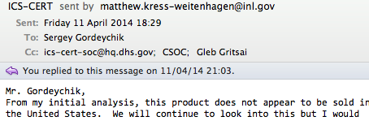
FyN
Don’t patch too much

Slide 59
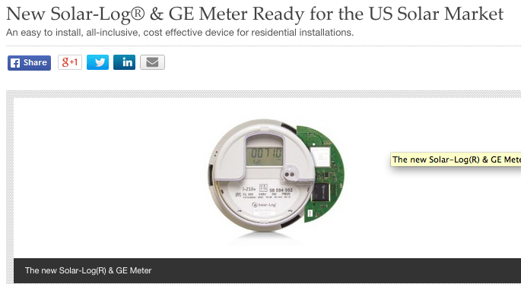
FyN
Wait a second….

Slide 60
Projects
We work with responsible disclosure approach
Full disclosure = all vuln details immediately in the wild. Giving the vendors absolutely no opportunity to release a fix
Responsible disclosure = researcher contacts the vendor before the vulnerability is released. And all stakeholders agree to allow a period of time for the vulnerability to be patched before publishing the details.
Because vulnerability patching very important for ICS and can take months. Even years.

Slide 61
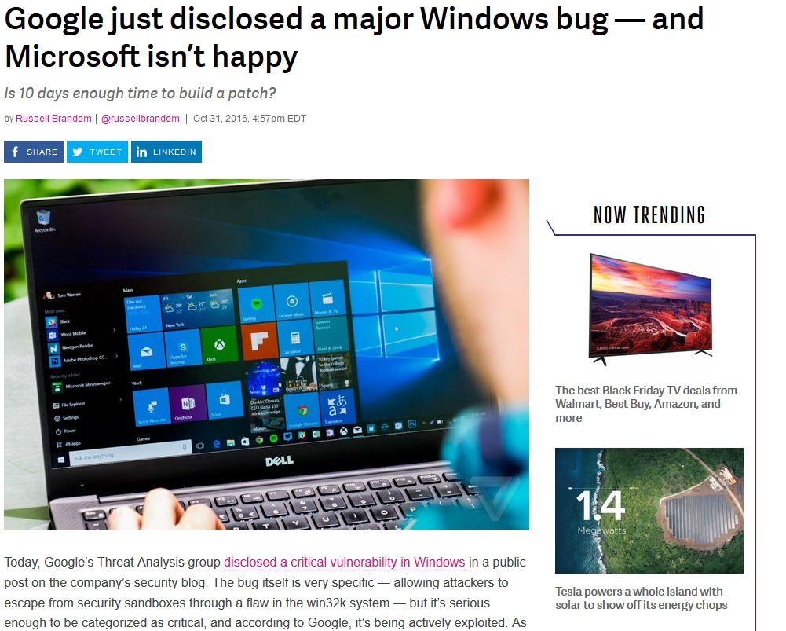
Projects
That’s why responsible disclosure in ICS highly important

Slide 62
Projects
Research
We send details directly to vendor and CERT
Vendor create CVE
Vulnerability patched
SCADASL public disclosure and exploit/toolkit publishing
Applause to SCADASL
Research
…

Slide 63
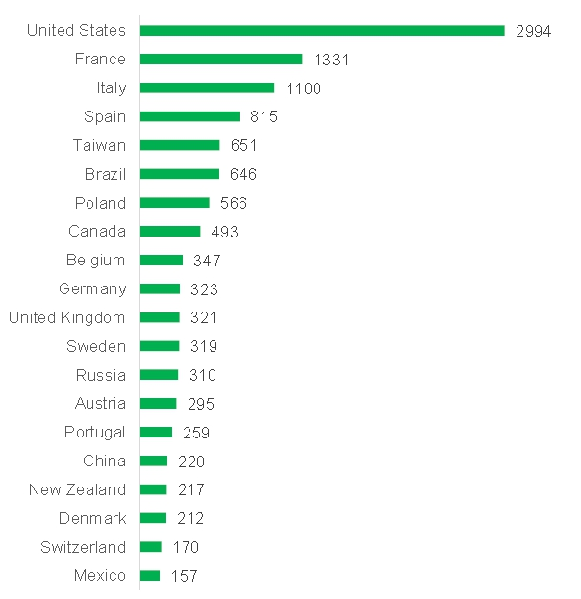

Projects
Analytics every year:
ICSMAP
ICSDORKS

Slide 64
Projects
#SCADAPASS
  Release 1.2
  37 vendors
  PLC, RTU, gateways, switches, servers …

Slide 65
Projects
#SCADASOS
(un)Secure Open SmartGrids is open initiative to rise awareness on insecurities of SmartGrid, Photovoltaic Power Stations and Wind Farms

Slide 66
Projects
Q: How to participate
A: Find Internet-connected PV and Wind power stations and notify vendors/CERTs/community.
Q: Wow! It simple! Can I hack it?
A: No. It can be a hospital or your grandma’s cottage. Please use passive approach (firmware analysis, testbeds etc.)
Q: I get an 0day!
A: Please submit it to vendor and/or regional CERT
Q: What will I get?
A: Kudos at SCADA StrangeLove Talks/Knowledge/Safer World.
Details
You can make shodan saved search or drop google dorks to twitter
Please use tags #solar #wind #scadasos

Slide 67


Projects
60 000+ SmartGrid devices disconnected from the Internet
Two Advisories
  XZERES 442SR Wind Turbine CSRF
  SMA Solar Technology AG Sunny WebBox Hard-Coded Account Vulnerability

Slide 68
Projects
Current and future:
Smart energy generation
Rail road and signaling systems
Digital substations
GSM/GPRS modems

Slide 69

Results
Well-known and habitual world of information security growing up, evolving, changing quickly
Because a lot of specialists involved in it
Unfortunately ICS security area not very mobile and changeable
Also our team members growing old, starting a families
We think that our mission done successfully

Slide 70


Results
But not finished yet….

Slide 71

Results
Still trying to hack ICS, son?
Have you ever heard
about
SCADASTRANGELOVE ?!

Slide 72

Results
All materials at SCADA.SL
We hope that our work can help you create your own projects. But don’t forget about community and responsible disclosure principle

Slide 73

Thank you
Alexander Timorin
Alexander Tlyapov
Alexander Zaitsev
Alexey Osipov
Andrey Medov
Artem Chaykin
Denis Baranov
Dmitry Efanov
Dmitry Nagibin
Dmitry Serebryannikov
Dmitry Sklyarov
Evgeny Ermakov
Gleb Gritsai
Ilya Karpov
Ivan Poliyanchuk
Kirill Nesterov
Roman Ilin
Sergey Bobrov
Sergey Drozdov
Sergey Gordeychik
Sergey Scherbel
Timur Yunusov
Valentin Shilnenkov
Vladimir Kochetkov
Vyacheslav Egoshin
Yuri Goltsev
Yuriy Dyachenko
*All pictures are taken from google and other Internets

